Slide 1
Welcome to the Webinar!
We will begin momentarily…

Slide 2
Today’s Speakers

Slide 3
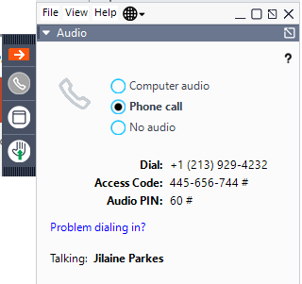
Joining via Phone Call
If you're having trouble dialing in, select Problem dialing in? for an alternate line.

Slide 4
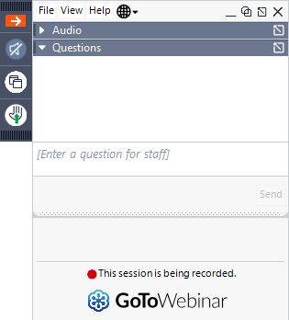
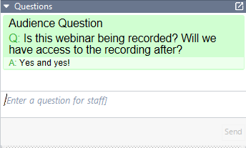
Your Questions Today
We will do our best to address your specific questions! Please utilize the “Questions Log” below in your dashboard & identify your #1 question / concern...

Slide 5
Information Share / Follow Up
A recording of today's broadcast will be provided to you in a follow up email tomorrow.

Slide 6
Overview
Definition of Employee vs. Independent Contractor
Benefits of Hiring and Employee or Independent Contractor
Legal Classification of Employees vs. Independent Contractors
Risks of Getting the Classification Wrong
Questions / Answers

Slide 7
Definitions What are the differences between an 'Employee' and an 'Independent Contractor?'

Slide 8
Definitions – EMPLOYEE
Protected under the common law and employment legislation, ESA, which includes minimum wage, overtime, termination, holidays and notice
Covered by Workers’ Compensation legislation
Typically have an exclusive working relationship with the employer
Adhere to Code of Conduct and/or subject to Company Policies

Slide 9
Definitions – EMPLOYEE
Have Income Tax, Canada Pension Plan, and Employment Insurance payments automatically deducted from your pay cheque and remitted on your behalf (otherwise known Source Deductions – viewable on paystub)
May have employer-paid benefits coverage (sometimes partial) such as health care, STD/LTD (sick leave), pension plan, professional development allowances
Cannot claim tax benefits (e.g., deduct. for work-related expenses)

Slide 10
Definitions – INDEPENDENT CONTRACTOR
Deemed self-employed and therefore are not covered by employment legislation
Arrange and pay for own insurance for work-related accident / illness coverage
Can work for other organizations

Slide 11
Definitions – INDEPENDENT CONTRACTOR
No Source Deductions taken from client, you are responsible for filing own tax, Canada Pension Plan, and Employment Insurance payments to the government, responsible for own benefits coverage
Acceptable to claim 'reasonable' business expenses as deductions on your yearly income tax returns

Slide 12
Benefits for the Company
Hiring an Employee:
Tenure
Consistent Internal Approach – onboarding/offboarding
Less Risk of Re-classification
Hiring an Independent Contractor:
Not required to provide benefits
Payroll deductions do not need to be calculated (less time/resources)
More flexibility to meet labour/cashflow fluctuations

Slide 13
Legal Classification
Legal Classification / Tests

Slide 14
Legal Tests: Employee vs. Independent Contractor
Canada – Two different Acts:
1. Income Tax Act – 5-point test:
Intention of the Parties
Control
Ownership of Tools
Chance of Profit/Risk of Loss
Integral part of the Business/Dependency

Slide 15
Legal Tests: Employee vs. Independent Contractor
2. Employment Legislation: Is the worker in business for his/herself?
The level of control the entity has over the worker’s activities.
Whether the worker provides his/her own equipment.
Whether the worker hires his/her own helpers.
The degree of financial risk taken on by the worker.
The degree of responsibility for investment and management held by the worker.
• The worker’s opportunity to profit from own tasks.

Slide 16
Risks of Misclassification

Slide 17
Risks of Misclassification:
Fines
Payment of source deductions
Tax consequences for both parties
Overtime, Vacation Pay
Class Action Suits

Slide 18
Legitimate Industry Contracts?
Grant Based
NFP – Fund-Raising Projects
Advertising / Marketing Agency - 'Freelancer'
IT
CRA Proof?

Slide 19
How to Hire an Independent Contractor

Slide 20
How to Hire an Independent Contractor
• Services Agreement vs. Employment Agreement – key is more than just the title
Hiring process
Terms of the contract – liability, indemnity, exclusivity, service levels
Onboarding
Policies/Employee Handbook
Managing Performance
Workplace conduct on / offsite

Slide 21
Case Study
Organization X hired a 'contractor' for a three-month duration. The discussion with the individual was that the contract could possibly turn into a permanent, full-time position. The employer chose to use the Contract as more of an assessment period of performance. During that time, the 'contractor' was provided a phone, laptop and business cards.

Slide 22
Questions & Answers

Slide 23
Thank you to our Presenters today.
Christine.holmes@lawyersinhouse.com
Direct Line: 416.357.6887
Jparkes@sprigghr.com
Direct Line: 416.317.2164

